Slide 1
Digital Portfolio
STUDENT NAME: SENTHAMIZH.E
REGISTER NO AND NMID: 24132161802522094 NMID:3B033091A9C6B3595104EF8F7AC4B2A4
DEPARTMENT: COMPUTER SCIENCE
COLLEGE: COLLEGE/ UNIVERSITY GOVERNMENT ART’S AND SCIENCE COLLEGE THIRUVENNAINALLUR/ANNAMALAI UNIVERSITY

Slide 2
PROJECT TITLE
ANIMATED NAVIGATION

Slide 3


AGENDA
Problem Statement
Project Overview
End Users
Tools and Technologies
Portfolio design and Layout
Features and Functionality
Results and Screenshots
Conclusion
Github Link
3/21/2024 Annual Review

Slide 4

PROBLEM STATEMENT
Traditional website navigation is often static and unintuitive.Poor navigation leads to higher bounce rates and a frustrating user experience.Need for a dynamic, interactive navigation system to enhance user engagement.

Slide 5

PROJECT OVERVIEW
Objective: To design and implement an animated navigation system that improves user interaction.Type: Front-end Web Development ProjectScope: Navigation components, animations, responsive designOutcome: Smooth, visually appealing user journey through the website.

Slide 6

WHO ARE THE END USERS?
UI/UX DesignersWeb DevelopersBusiness WebsitesPortfolios and Creative AgenciesEducational Platforms

Slide 7

TOOLS AND TECHNIQUES
Languages: HTML5, CSS3, JavaScriptLibraries/Frameworks: GSAP (GreenSock), Anime.js, React (if applicable)Design Tools: Figma, Adobe XDVersion Control: Git, GitHubDeployment: Netlify / Vercel

Slide 8
POTFOLIO DESIGN AND LAYOUT
Homepage: Hero section with animated navigation barMenu: Slide-in/overlay animated menuPage Transitions: Smooth fade and scale effectsResponsive Design: Mobile, tablet, and desktop-friendlyColor Scheme: Modern, clean, high-contrast palette
8

Slide 9
FEATURES AND FUNCTIONALITY
Animated hover effectsScroll-triggered navigationActive state indicatorsBurger menu for mobile viewDark/light mode compatibilitySmooth transitions between pages

Slide 10
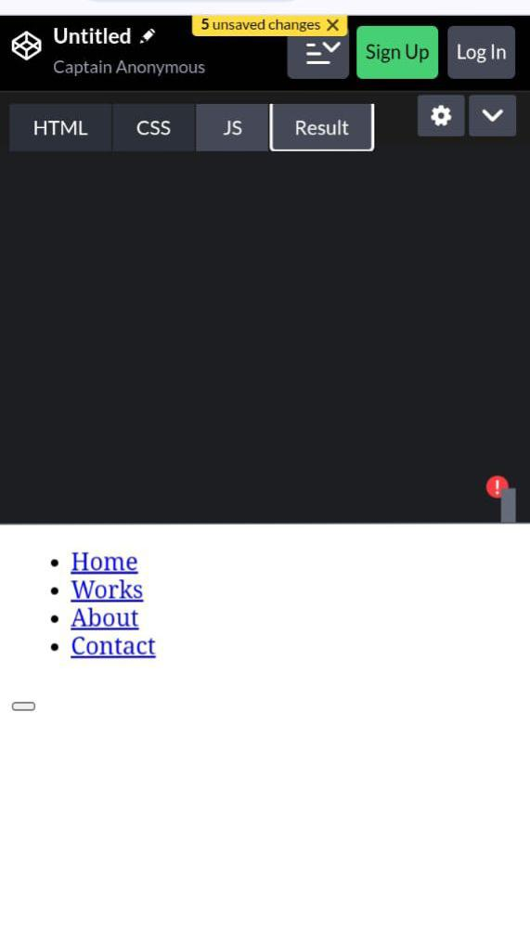

RESULTS AND SCREENSHOTS
3/21/2024 Annual Review
10

Slide 11
CONCLUSION
Successfully implemented a responsive, animated navigation system.Enhanced user experience through modern UI/UX techniques.Scalable and easily integrable into other web projects.Future scope includes adding accessibility features and CMS integration.
11

